Slide 1
PEFC supporting FLEGT in Myanmar
March 7th 2016
Myanmar Interim Taskforce
Rciahrd Laity
PEFC International

Slide 2
What is PEFC? Programme for the Endorsement of Forest Certification
Global alliance (not-for-profit association) of national forest certification organizations
Voluntary mechanism promoting sustainable forest management providing independent, third party certification of good practices
World's largest forest certification system, providing 60% of the certified forest area
Offers specific consideration to the unique needs of small and family forest owners while being equally used by large landowners

Slide 3
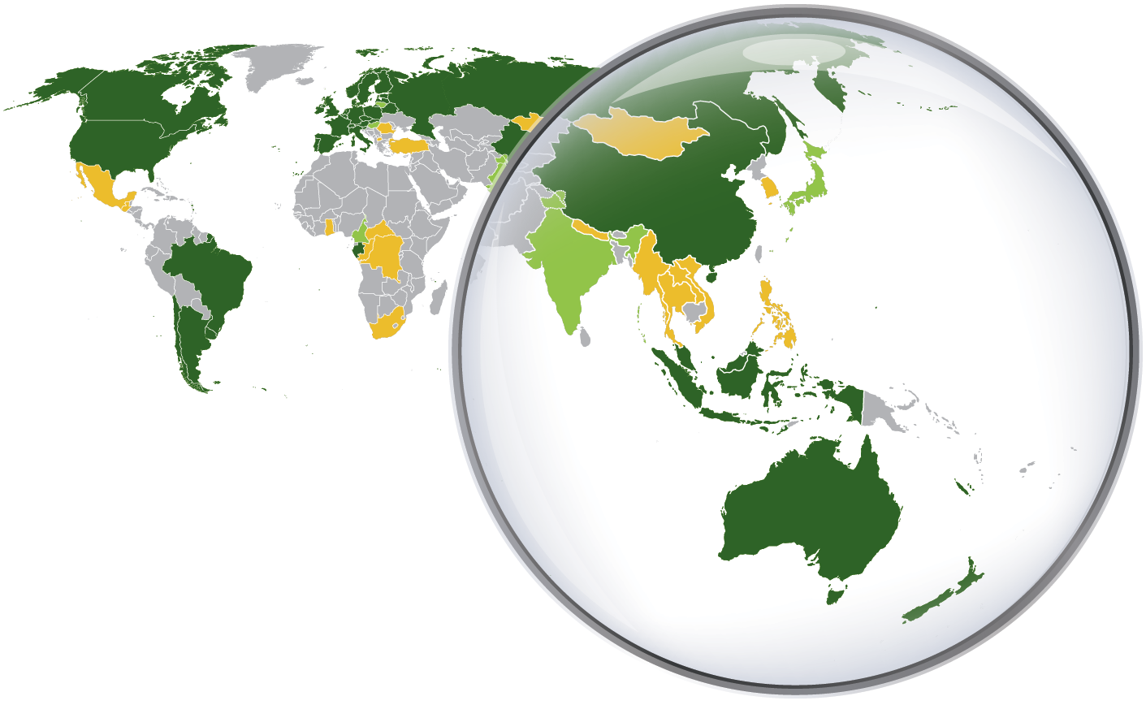
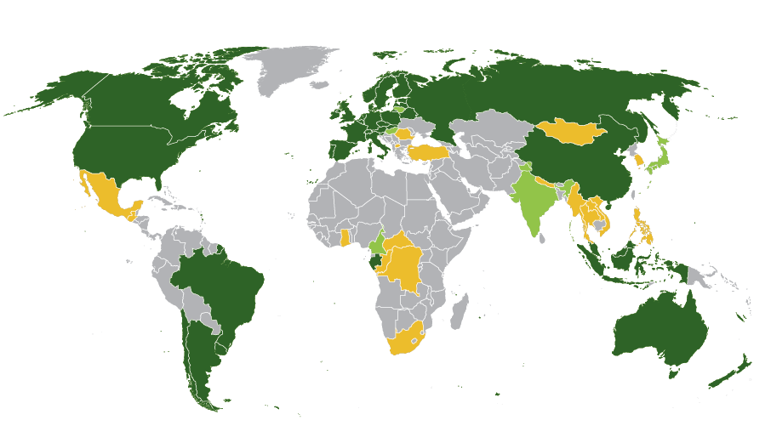
National Certification System status in Asia Pacific
PEFC members with endorsed systems
PEFC members progressing towards endorsement
Countries actively developing systems
As of February 2016

Slide 4
Certification Scheme Components

Slide 5
Key Organizations
IAF
AB
Standards
Accredits
PEFC
NGB
CBs
Notifies

Slide 6
Delivering Certificates
Myanmar Forest Certification System
IAF
AB
Standards
Accredits
PEFC
NGB
CBs
Issue certificates
Notifies
Chain of Custody
Access & improve standards
Forest Management
via Group Certification

Slide 7
Quality Infrastructure Requirements for Certification and FLEGT
Component | PEFC | FLEGT VPA
Accreditation Bodies | National Accreditation Bodies (members of International Accreditation Forum) PEFC Associate member within the IAF | Generally not applicable unless verification element of TLAS is done by independent 3rd party certifiers (e.g. SVLK)
Scheme Managers | Independent organizations with membership within the PEFC Council | VPA Joint Implementation Committee (JIC)
Legality Standards | PEFC Controlled sources | Legality Definition (TLAS)
Sustainability standards | National Standards (PEFC- Endorsed) | N/A
Chain-of-Custody requirements | CoC Standard | Supply Chain Controls (TLAS)
Certification Bodies | PEFC-notified and accredited to national accreditation body | N/A unless VPA uses independent verification (e.g. SVLK)
Auditors (Independent, government) | Independent | Government Officer and/or Independent (e.g. SVLK)
System auditors, independent monitors | The PEFC Endorsement and Mutual Recognition process; includes PEFC Approved Independent Assessors & Panel of Experts International and National Complaint Mechanisms | VPA Evaluators or Auditors (at least once per year and appointed by JIC), Independent Forest Monitoring (CSO)

Slide 8
Synergies between FLEGT and Cert.
Examples of synergies between the verification systems
Coordinated consultation and development of the systems
Compatible legality or sustainability standards leading to (mutual) recognition
Compatible CoC/traceability (Voluntary Schemes) and Supply Chain Controls (VPA)
Joint review of standards (VPA-Joint Implementation Committees/technical working groups, Scheme Managers, Standard Development Groups)
Multi-purpose verification training for independent or government auditors/inspectors
Multi-purpose audits/inspections
Reinforced linkages between Scheme Assessors and VPA Auditors
Reinforced linkages between Independent Forest Monitoring and Complaints Mechanisms
Note: If VPA TLAS uses independent 3rd party verification,
more synergies can be envisaged

Slide 9
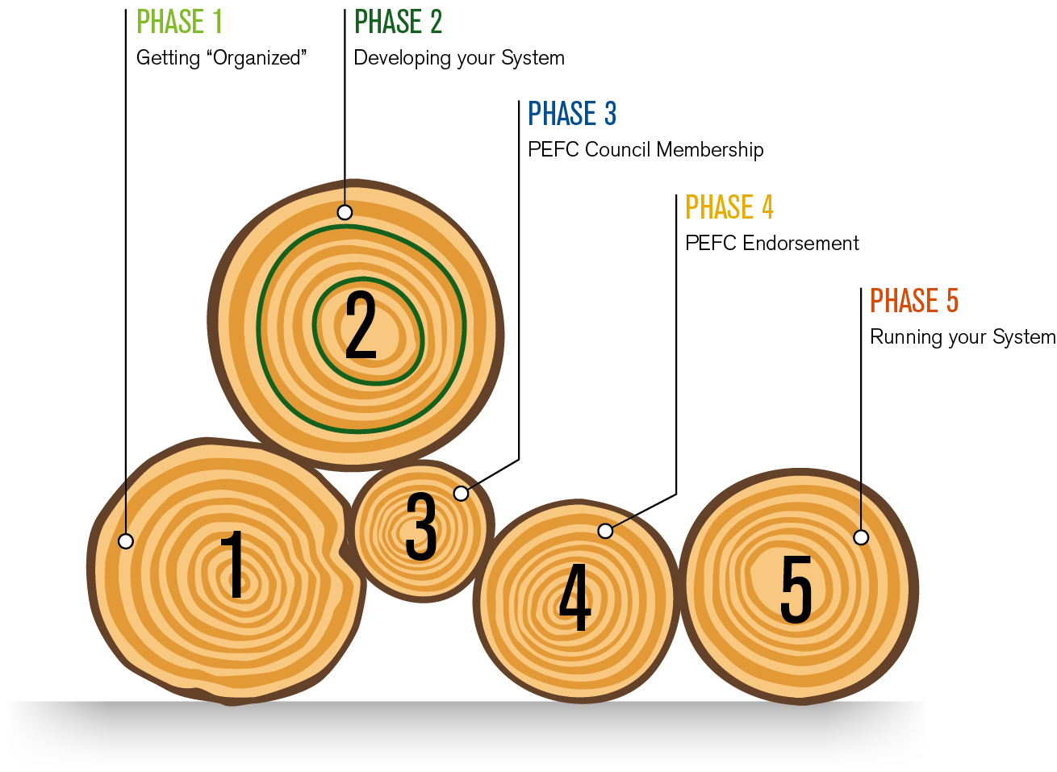
Developing MFCC

Slide 10
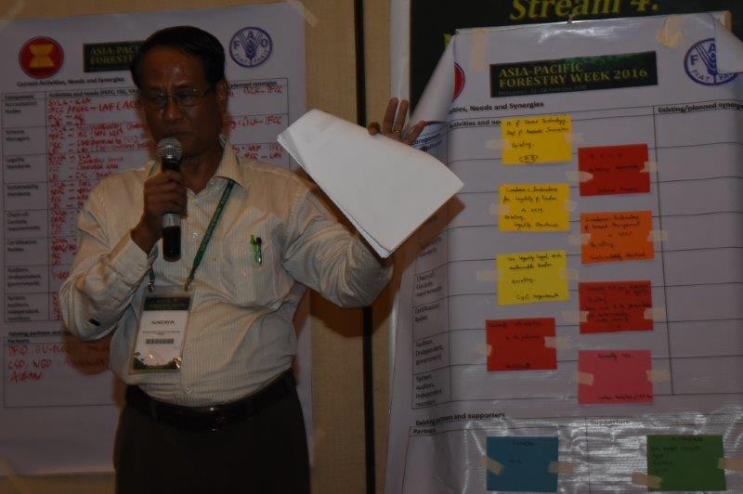
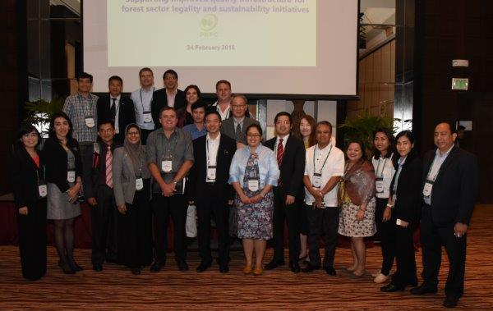
Developing Capacity for MFCS

Slide 11
POTENTIAL STUCTURE FOR SFM + LEGALITY QUALITY INFRASTRUCTURE PROJECT IN ASEAN
ASEAN SECTRETARY GENERAL
Please note: This is for illustrative purposes and is not approved by ASEAN. For internal use only.
WG= Working Group
ASEAN Economic Community Development
Market Integration Directorate
Finance and Industry Directorate
ASEAN Ministers of Agriculture and Forestry (AMAF)
ASEAN Economic Ministers
Trade and Facilitation Division
Food, Agriculture & Forestry Division
2016-2026 Vision and Strategy’s
ASEAN Consultative Committee on Standards and Quality (ACCSQ)
WG Pan ASEAN Timber Certification Initiative (PATCI)
WG 1. Standards
WG 2. Conformity Assessment
WG 3. Legal Metrology
Lead by Malaysia
Current Chair: Philippines (FMB)
Incoming chair: Thailand (RFD)
Chair: Malaysia (Std My)
Co-Chair: Thailand (TISI)
Improving Standards and Conformance Infrastructure in Forest Legality and Sustainability Project

Slide 12
Thank you! (Background Material)
richard.laity@pefc.org

Slide 13
Quality Infrastructure Requirements for Certification and FLEGT
Component | PEFC | FSC | FLEGT VPA
Accreditation Bodies | National Accreditation Bodies (members of International Accreditation Forum) PEFC Associate member within the IAF | Accreditation Services International | Generally not applicable unless verification element of TLAS is done by independent 3rd party certifiers (e.g. SVLK)
Scheme Managers | Independent organizations with membership within the PEFC Council | FSC, with National Standard Development Groups | VPA Joint Implementation Committee (JIC)
Legality Standards | PEFC Controlled sources | FSC Controlled Wood | Legality Definition (TLAS)
Sustainability standards | National Standards (PEFC- Endorsed) | FSC Interim National Standards or Approved National and Regional Standards | N/A
Chain-of-Custody requirements | CoC Standard | CoC Standards | Supply Chain Controls (TLAS)
Certification Bodies | PEFC-notified and accredited to national accreditation body | FSC accredited | N/A unless VPA uses independent verification (e.g. SVLK)
Auditors (Independent, government) | Independent | Independent | Government Officer and/or Independent (e.g. SVLK)
System auditors, independent monitors | The PEFC Endorsement and Mutual Recognition process; includes PEFC Approved Independent Assessors & Panel of Experts Maintains clear separation between standard-setting, conformity assessment and accreditation functions in line with globally recognized ISO best practice. International and National Complaint Mechanisms | FSC and ASI both full members of ISEAL, undergo independent evaluation against ISEAL's Codes of Good Practice. FSC Policy for Association mechanism, protects system from reputational risk from organizations involved in unacceptable activities Complaints mechanisms and Dispute Resolution System | VPA Evaluators or Auditors (at least once per year and appointed by JIC), Independent Forest Monitoring (CSO)

Slide 14
Relation to ISO Framework
IAF Procedures
ISO/IEC 17011
PEFC ST 1003:2010 PEFC GD 2003:2012 PEFC ST 2002:2013 (PEFC ST 2004:201X) National documentation
PEFC ST 1001:2010 National documentation
ISO
ISO/IEC Guide 59 ISO Guide 82 ISO/IEC Guide 2 ISO/IEC 17007
ISO/IEC 17021
ISO/IEC 17065
ISO 19011

Slide 15
PEFC complaints mechanism
IAF
AB Complaints Mechanism
ISO/IEC 17011
IAF
Not satisfied
IAF PR1:2004
Satisfied
Not satisfied
CB Complaints Mechanism
AB
Satisfied
IAF Complaints Mechanism
Satisfied
NGB Complaints Mechanism
ISO/IEC 17065 ISO/IEC 17021
GL7/2007
PEFC Complaints Mechanism
Not satisfied
NGB
CB
Not satisfied
GL7/2007
CE Complaints Mechanism
PEFC
PEFC
PEFC ST 1003:2010 PEFC ST 2002:2013 National documentation
Certified entity
Dispute
Satisfied

Slide 16
Summary/Next steps
Aspect | PEFC Input
Accreditation | - IAF Liaison - AB support, training
Scheme Development | -Technical support to ongoing national processes - ASEAN involvement in PEFC International Revisions Process
Legality/ Traceability | - Promote Chain of Custody Certification throughout supply chains
Certification Bodies/Auditors | -Training and Training Recognition program
To support the establishment of robust, accessible, cost-effective forest certification in ASEAN.

Slide 17
Main Steps for Myanmar

Slide 18
Certification Scheme Structure
Implementation Procedures
Administrative Procedures
Standard Setting
Standard Setting Procedures
Forest Management Standards
Notification of CBs
Certification and Accreditation Procedures
Chain of Custody Standard
Group forest management certification procedures
Disputes & complaints procedures
Logo usage licensing
Notes:
This table looks more closely at what documents – procedural, guidance or normative documents – need to be included in a national certification scheme.
- For some of these – like Chain of Custody - you can utilise PEFC International Stds
For others, you will need to closely read and understand PEFC International’s requirements, but then develop you own documentation
Forest Management Standard is just one document…

Slide 19
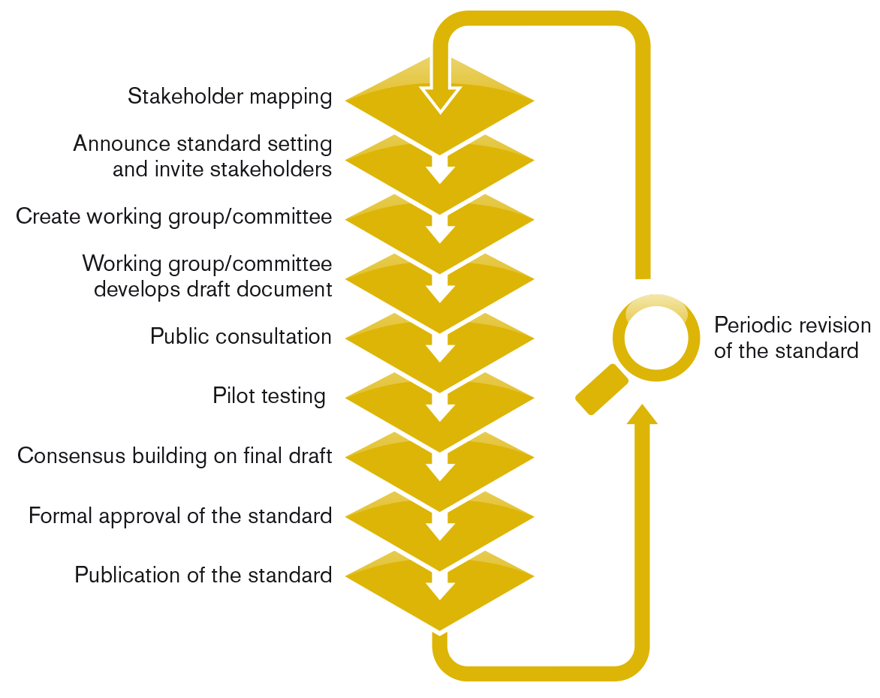
PEFC Standard Setting Process
Notes:
You can either explain the process with this one slide, or use the 6 slides that follow to present more detail.

Slide 20
International
Sustainability
Benchmarks
Global public consultation
Independent assessment
Panel of Experts
Board recommend-ation
Approval by members
Revision required
National Standard
Pilot testing
National public consultation
Consens-based decision making
Multi-stakeholder process
Application for Scheme Assessment
Notes:
PEFC’s bottom up approach contains a number of unique elements that ensure the robustness of the system and are not found in any other global forest certification system:
All standards are developed with stakeholder participation
All standards are assessed by an independent consultant for compliance with international requirements; assessment reports are available on www.pefc.org
Responsibility for approval lies with the General Assembly
All national standards must be revised every 5 years.
Further information about national standards: http://pefc.org/standards/national-standards and http://pefc.org/standards/national-standards/guidance
Further information about the endorsement process: http://pefc.org/standards/endorsement-mutual-recognition

Slide 21
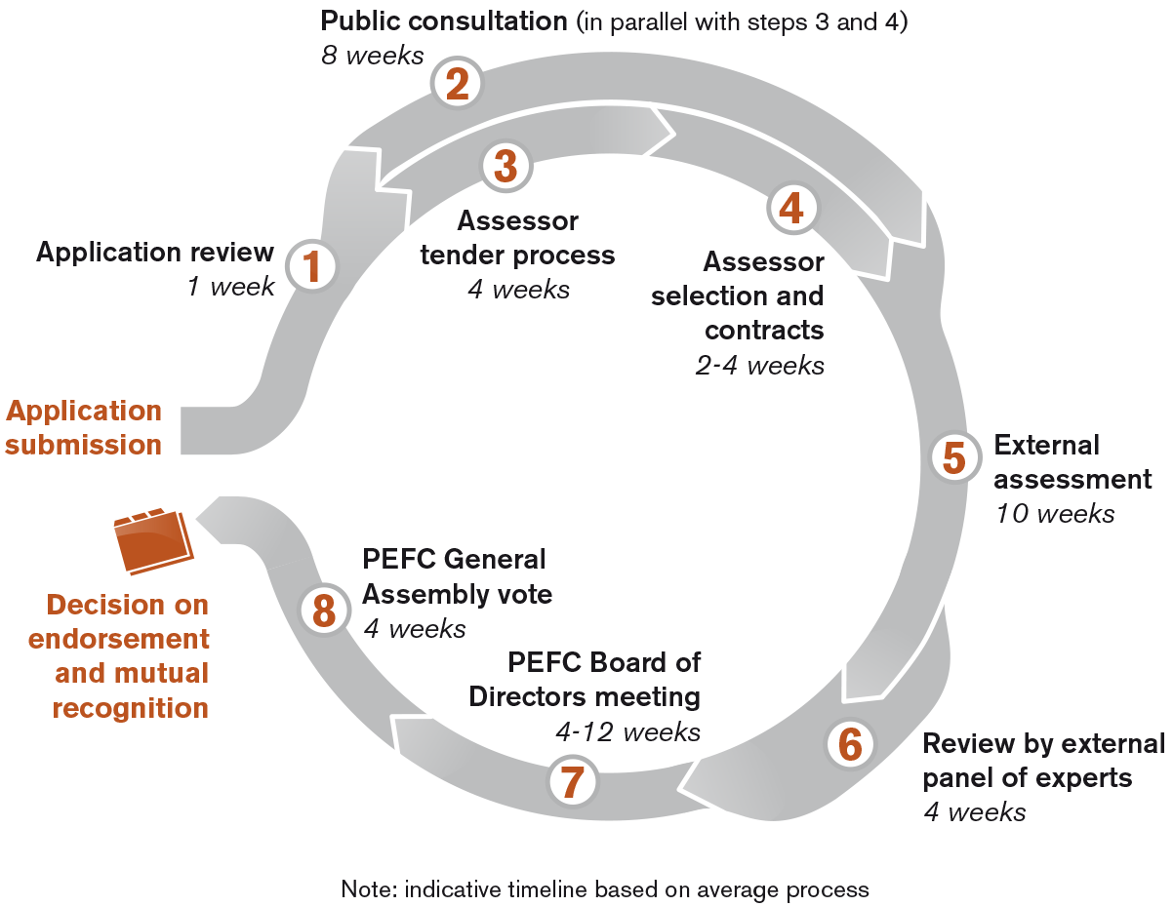
PEFC endorsement process

