Slide 1
Working in partnership to bring sustainable management to Myanmar's forests
22nd of February 2018
Webinar
Richard Laity
PEFC International

Slide 2
Overview
Agenda | Responsible | Note
Opening Remarks | MFCC
1. Overview of Project | Richard Laity, PEFC International | Q and A included
2. Project Update | Barber Cho, MFCC | Q and A included
3. Project Plan | Wynn, MFCC | Q and A included
4. Supply Chain Partners Internal Discussion | Richard | For selected participants only

Slide 3
MFCC/PEFC Project
Working in partnership to bring sustainable management to Myanmar's forests
2017-2020

Slide 4
Overview of the project
focus on delivering a national forest certification system with global reconignition
develop and test tools which support legal, sustainable and transparent forest product trade
build capacity while illustrating best practice
increasing the coordination between the many related donor and private sector projects & initiatives

Slide 5
Workplan

Slide 6
1. National Scheme Development
MFCC will lead the process:
Continue to convene stakeholders
Build consensus on SFM
Provide a tool for forest managers and processors
Providing flagship examples of best practice:
Stimulate policy development
Build capacity
Influencing the mainstream operations.

Slide 7
2. Knowledge Platform
Establishment of a multi-stakeholder platform for:
coordination and exchange amongst actors
share findings, tools and best practice
access technical support for certification solutions
Members in the platform will:
be able to implement solutions
participate in events including:
support MFCC decision making.
share information on their organization and market needs
access training and employment opportunities.
5.
Like @pefcmyanmar on facebook to be included

Slide 8
3. FM Pilot Projects:
Pilot projects will focus on:
Natural Forests – Pilot FMU’s
Enhance Community Forests Value Chains
3) Existing Plantations – Private teak and rubber
Future Plantations – concessionaires etc
For each forest type:
Identifying pilot sites for certification
Complete gap assessment to identify interventions
Support capacity building and implementation

Slide 9
4. Supply Chain Pilot Projects
Implementation of a step wise approach.
Develop tools for companies to implement supply chain verification
Partners will benefit through:
Assessing innovation and technical solutions
Address needs for the:
Upstream - training and capacity building
Downstream - engage actors
Developing the MFCC CoC technical department which support PEFC CoC in Myanmar

Slide 10
Q and A
Any questions about the project generally?

Slide 11
Update
Progress to date

Slide 12
Key Progress
MFCS
Development
Secretariat staff (CEO, Technical Officers & Assistants) employed and inducted
Reform MFCC, statutes drafting committee enacted
Links with National and ASEAN Accreditation Bodies
Completed detailed and integrated workplan
Knowledge Platform
Seminars at University, Forest Department and MTE
Links with FLEGT processes through ITF
Facebook page updated with 400+ followers
Forest Management
FM Auditor training completed for key staff/CB
Identified FMU’s for completing verification activities
Supply Chain
Stepwise approach agreed
Engaged international buyers and national exporters
Partnered with Double Helix to support clients
CoC training for key staff completed

Slide 13
Overview of MONREC including MFCC and FLEGT Structures
MINISTRY OF NATURAL RESOURCES AND ENVIRONMENTAL CONSERVATION (MONREC)
FLEGT
Forest Department
MTE
Palladium
Myanmar Forest Certification Committee
Advisor
Interim Task Force (ITF)
COMMITEE
24 STAKEHOLDERS
FLEGT FOCAL PERSON
SECRETRAIT
SECRETRAIT
MTLAS
PEFC Project
Notes:
Important to note that all the bodies are under MONREC/ ITF is important, however they all have their role.

Slide 14
MFCC Secretariat Structure
MFCC
Chairman & Members
Complaints Committee
Other Committees
CEO
Mr. Win Hlaing
Forest Management
Technical Officer
Ms. May Zun Phyo
Admin / Finance/ Communication
Mr. Aung Kyaw Soe
Ms. Htet Htet Kyaw
Ms. Nan Htet Htet Ei Win
Forest Products
Technical Officer
Ms. Thawdar Nyein
Assistant
Ms. Moh Moh Mg Zin
Assistant
April Khaing Oo
(Standards)
Assistant
Ms. Yu Yu Mon

Slide 15
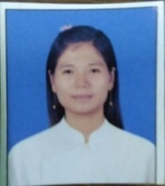
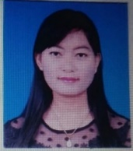
MFCC Team
 | Name (role) | Experience
 | Wynn Hliang (CEO) | Former DDG Planning and Forest Inventory for 27 yrs Consultant including FFI Certification Consultant and MTLAS Gap Assessment
 | Thawdar Nyein (Technical Officer) | Supervisor for 6 Months Phyo Si Thu Co.,Ltd teak plantations, Field Volunteer for ALARM, 1 year in Friends of Wildlife, 1 yr for MFCC MTLAS Gap Analysis Project and PEFC project
 | May Zun Phyo (Technical Officer) | 1 year in quality Great Wall Co.,Ltd and 3 years project project officer in Friends of Wildlife, Flora and Fauna Consultant for RAMBOLL ENVIRON Myanmar Co.,Ltd
 | April Khaing Oo (Scheme Assistant) | 3 years experience including quality control in Great Wall company, GIS and databases at Tanintharyi Nature Reserve and an Intnern at wildlife Conservation Society and IUCN
 | Moh Moh Mg Zin ( FM Assistant ) | Worked in asssisting in Ph.D thesis as assistant. Including work experience in data collection for WCS and Emref.
 | Moh Moh Mg Zin (Supply chain & Coms) | 4 years of experience in students and adult with PfC & Inle. Managing and teaching ESL Programs in the Inle Lake region. Interpreter of Rule of Law Center

Slide 16
Stepwise for SFM in MFCC project
PEFC Certified
Risk Mitigation
International Recognised Labelling
FM Std environment social, economic standard
PEFC DDS Controlled Sources
MTLAS (2)
International 3rd party accreditation and CB’s
MTLAS (1)
3rd Party
National 3rd Party Accreditation and CB’s
3rd Party verification system
Registered CB
Core forest values (no controversial sources)
1st party
2nd party
MTLAS P&C
No claim
MTLAS P&C
Verified legal
Unverified statement of origin
Buyers direct assessment
Source unknown
Traceability system
Traceability system
Full chain of custody system
Available now
<1 yr
>1 yr
Available now
>2 yrs
Wood (Category) Claim
Notes:
Laity and Crawford 2012

Slide 17
Q and A
Any questions on the project update?

Slide 18
Project Plan

Slide 19
Year 1 Workplan (1)

Slide 20
Year 1 Workplan (2)

Slide 21
Work Plan for MTLAS Phase I (revised 2, 21 Feb)
No | Date | Remarks
1 | 1 Feb - forward | Finalize the TORs and Contract for Consultant and Experts
2 | 1 Feb - forward | To develop the MFCS documents
3 | 1 Feb - forward | Preparation for the Webinar
 |  | -Video communication
 |  | -Work Plan, input and output for MTLAS Phase I
 |  | -To identify 17/18 extraction parts that will be verified to prepare a workplan
 |  | for the CB's after their auditors are competent
4 | 21 Feb - 15:30 | Webinar
5 | 25 - 28 Feb | Documentation Consultant 1st trip, Documents developed
6 | Last week of Feb | To hire the social experts
7 | 11 - 15 March | Preparation for the MTLAS Participatory Assessment Training Part 2
8 | 13 - 17 March | CoC Participatory Assessment Training Part 1
9 | 16 -22 March | MTLAS assessment (Full package ) by CBs, guided by Mr. Gan
10 | Last week of March | MTLAS system assessment on 17/18 harvest area by CBs
11 | Last week of March | ISO training
12 | 1st week of April | CBs become competent and ready to do auditing/verification
13 | Q2, Q3 | Forestry Pilot Project, FMU, Certified Forest (SFM),

Slide 22
Q and A
Any questions on the project plan?

Slide 23
Supply Chain Verification Discussion
Private Sector Dicussion

Slide 24
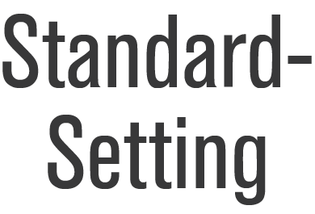
MTLAS processes (2017-19)
MFCC
MTLAS P& C
Guidance Docuements
MTLAS CB Requirements
MTLAS
MTLAS
Auditor Requirements

Slide 25
MTLAS incorporated in MFCS
Myanmar Forest Certification Scheme
IAF
DRI
Standards
Accredits
PEFC
MFCC
CBs
Issue certificates
Notifies
SCHEME DOCUMENTS
MTLAS
CoC
MTLAS

Slide 26
Workplan for Supply Chain Partners

Slide 27
Background

Slide 28
Component | MTLAS (Phase 1) | MTLAS (Phase 2) | PEFC
Scope & Claims | Consignment and operator (verified) | Consignment and Operator (legality claim) | Operator (PEFC Controlled sources and PEFC Certified)
Accreditation Bodies | Completed by MFCC (with MTLAS system documents) | Department of Research and Innovation | National Accreditation Bodies PEFC Associate member within the IAF
Scheme Managers | MFCC | MFCC (in cooperation with MSG to update latest legality requirements) | Independent organizations PEFC Council membership
Legality Standards | MTLAS P&C V.1 | MTLAS P&C V.X (using latest Legality Definition) | PEFC Controlled sources
Sustainability standards | (within legality) |  | National Standards (PEFC- Endorsed)
Chain-of-Custody requirements | MTLAS C&I V.1 | MTLAS C&I V. X (using latest Legality definition) | CoC Standard
Conformity Assessment Body (CAB) | Certification Bodies (MFCC notified, registered by MFCC to meet MTLAS requirements) | Certification Bodies (MFCC notified, DRI accredited on MTLAS requirements) | PEFC-notified and accredited to national accreditation body
Auditors | Independent | Independent | Independent
System auditors, | MFCC board review | To be developed e.g Cooperation with the MSG IAF assessing DRI | The PEFC Endorsement and Mutual Recognition process; includes PEFC Approved Independent Assessors & Panel of Experts IAF checking AB’s
independent monitors | MFCC Complaints Mechanism | MFCC Complaints Mechanism | International and National Complaint Mechanisms

Slide 29
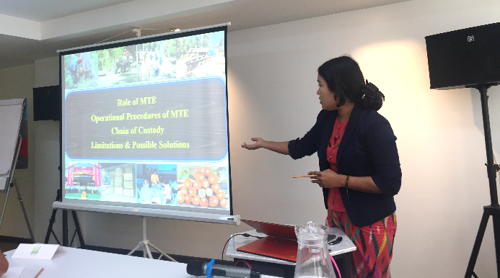
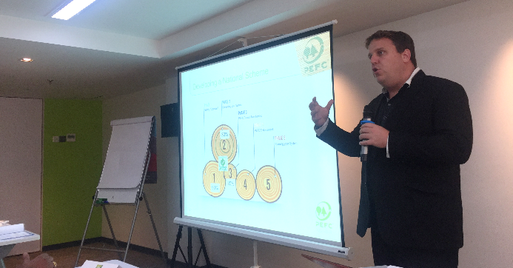
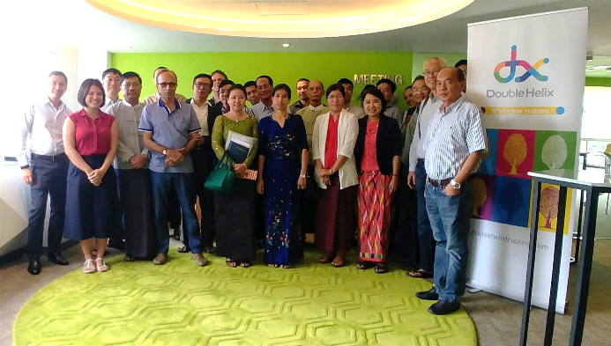
Partnering with Double Helix (DX) Event
Briefing held for industry partners
DoubleHelix presented updates to verification procedures
Myanmar Timber Enterprise presented updates on chain of custody document changes
PEFC briefed audience on MFCC/PEFC project
MFCC and FLEGT representatives present
DX and MFCC Agreement drafted
MFCC Auditor Capacity Building Plan Initiated

