Slide 1
Working in partnership to bring sustainable management to Myanmar's forests
3rd of August, 2017
Forestry Depantment
Richard Laity
PEFC International

Slide 2
Overview
Certification/Verification
Overview of verification processes
PEFC
PEFC’s unique approach
Technical Infrastructure
Synergies with FLEGT
Examples of synergies
Comparison of Infrastructure
The way forward
MFCC Project
Workplan
Partnerships for pilot projects
Get involved!

Slide 3
Certification and Verification Processes
Meeting market demands in an appropriate manner

Slide 4
International Market Requirement Pathways
Legality
FLEGT License
Private Standards
Government Assurance Systems
Accredited 3rd party systems
Due Diligence
Material sourcing
Production controls
Labelling/claims
EUTR/Lacey/Aus.
Controlled Sources
Private Policy
Public Procurement
Documentation
Quality system
Sustainability
Certification
Verification
Private policy
Notes:
Material sourcing - Certified, verified, non-certified, re-cycled
Production controls - Quantities, conversions, segregation/batches, “%-in, %-out”, record-keeping
Labelling/claims -Labels - on-product and off-product, claims
Documentation - invoices, shipping and sales
Quality system- Policies, procedures, staff, training, records, health & safety
‘
Production controls - Quantities, conversions, segregation/batches, “%-in, %-out”, record-keeping

Slide 5
Voluntary and Regulatory Approaches to Legal and Sustainable Timber
Sustainability
Forest Certification
(FSC, PEFC, national systems – legality
& forest management principles)
CITES
Public Procurement Policies
Voluntary (private)
Regulatory (government)
Private sector initiatives:
Verification of legal origin (VLO)
Verification of legal compliance
(VLC)
Codes of Conduct
Public Procurement
National export/import prohibitions
EU FLEGT: VPA and EU TR
US Lacey Act
AUS Illegal Logging Prohibition Act
National Systems on Timber Legality
(MY TLAS, SVLK)
ASEAN initiative for timber legality
Legality

Slide 6
Similarities and Differences
Similarities
    Trade : “utilizing the power of the discerning markets”
    Standard setting
    Stakeholder involvement during development and implementation
    Promoted/can be promoted by the government
    Third-party monitoring
Differences
Regulatory instruments | Voluntary
Legally binding (definitive) –TLAS is part of VPA | Voluntary (P & C is stand alone)
National level (reputation) | FMU level
Sector improvement (good governance, fair competition, level playing field, transparency) | Competitive advantage of the individual market participant
Legality (FLEGT - supply chain) | Sustainability (selected supply chain)

Slide 7
Wood Claims
Potential Risk Mitigation System
Full Certified
Scale and Intensity of impacts
Labelling
Full environment social, economic values
Controlled wood
Increasing costs and complexity
FLEGT Compliant
Verified legal
Core forest values
Verified legal
Licenced legal
Verified legal
Full chain of custody system
3rd party
Partial chain of custody system
2nd party
EU Approved CoC and Verification
1st party
3rd party but low level of assurance
No claim
Buyers direct assessment
Unverified statement of origin
Source unknown
Independent 3rd party accreditation
Courtesy: Flanagan and Laity, 2015
Category of Verification
Notes:
No Claim – direct sale, eg. Teak or acacia wood ships into China
1st Party – the grower
2nd party – the buyer
3rd party – facilitators (eg. Luang Prabang Teak Program)

Slide 8
Synergies between FLEGT and Certification
Developing and enabling environment

Slide 9
Examples synergies
VPA-TLAS and Certification
Certification -> FLEGT VPA processes
Pioneer best practice in countries, testing ground for case-based
solutions (e.g. group certification with smallholders)
Serve as working examples of standard development, traceability and auditing -> help develop realistic TLAS systems
Create awareness (building on “the willing”) in nat. and int. contexts
FLEGT VPA -> Certification
Provide clarity on legal requirements applicable to forest operations
Cover all timber sources, built on broad stakeholder consensus- Could serve as legality elements of certification standards
VPA improves framework for certification (transparency/accountability)

Slide 10
VPA-TLAS – Certification
Certification/legality verification schemes can be formally recognized in VPA and can lead to automatic FLEGT licensing if:
Standards of voluntary schemes cover VPA legality requirements
Control procedures (COC) cover VPA requirements
Government regulation recognizes certification/legality verification schemes based on prior VPA compliance assessment
Certification/legality verification can be used for:
Risk classification of companies (defining VPA verification intensity)
Organisational structures that internalize the legality requirements
Address legality assurance of imported timber
Certification/legality verification audits can replace government verification and can be multipurpose (VPA and voluntary schemes)

Slide 11
Infrastructure Requirements for Certification and FLEGT
Component | PEFC | FLEGT VPA
Accreditation Bodies | National Accreditation Bodies (members of International Accreditation Forum) PEFC Associate member within the IAF | Generally not applicable unless verification element of TLAS is done by independent 3rd party certifiers (e.g. SVLK)
Scheme Managers | Independent organizations with membership within the PEFC Council | VPA Joint Implementation Committee (JIC)
Legality Standards | PEFC Controlled sources | Legality Definition (TLAS)
Sustainability standards | National Standards (PEFC- Endorsed) | N/A
Chain-of-Custody requirements | CoC Standard | Supply Chain Controls (TLAS)
Certification Bodies | PEFC-notified and accredited to national accreditation body | N/A unless VPA uses independent verification (e.g. SVLK)
Auditors (Independent, government) | Independent | Government Officer and/or Independent (e.g. SVLK)
System auditors, independent monitors | The PEFC Endorsement and Mutual Recognition process; includes PEFC Approved Independent Assessors & Panel of Experts International and National Complaint Mechanisms | VPA Evaluators or Auditors (at least once per year and appointed by JIC), Independent Forest Monitoring (CSO)

Slide 12
Synergies between FLEGT and Cert.
Coordinated consultation and development of the systems
Compatible
  legality or sustainability standards leading to (mutual) recognition
  CoC/traceability (Voluntary Schemes) and Supply Chain Controls (VPA)
Joint review of standards (VPA-Joint Implementation Committees/technical working groups, Scheme Managers, Standard Development Groups)
Multi-purpose
  verification training for independent or government auditors/inspectors
  audits/inspections
Reinforced linkages
  Scheme Assessors and VPA Auditors
  Independent Forest Monitoring and Complaints Mechanisms
Note: If VPA TLAS uses independent 3rd party verification,
more synergies can be envisaged

Slide 13
The Programme for the Endorsement of Forest Certification
Introducing PEFC’s Unique Approach

Slide 14





PEFC Mission: a world in which people manage forests sustainably
UN Earth Summit
in Rio defines “sustainable development”
1992
First systems endorsed: Finland, Sweden, Norway, Germany
and Austria
2000
First non-European systems endorsed: Australia and Chile
2004
Over 200 million hectares of certified forest area
2007
43 PEFC National
Member organisations
2016
1999
PEFC founded in Paris by
11 countries, in response to the specific requirements of small family forest owners
2001
Integration of the Fundamental ILO Conventions in forest management
2005
Over 100 million hectares
of certified forest area with North America joining (SFI)
First re-endorsement: Finland
2009
First tropical countries endorsed: Gabon
and Malaysia
Notes:
Highlight 1999, 2001,2004.
June 2016: 43 members

Slide 15
What is PEFC?
Programme for the Endorsement of Forest Certification
Global, not-for-profit alliance of independent national forest certification systems promoting sustainable forest management
Independent system: auditing, certification and accreditation is done by third parties
Created to cater for small family forest owners and is also available to large public & private owners
World's leading forest certification system with credible standards, addressing globally and locally:
  social, environmental and economic benefits
Caring for our forests globally and locally
Provider of 60% of the world’s certified forest area.

Slide 16

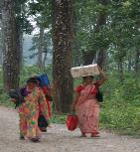
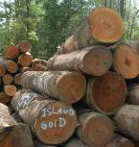
PEFC Certification and more...
Development of international standards (Sustainability Benchmarks)
Asessment & endorsement of national forest certification systems
Promote market access & market recognition
Collaborative impact projects to foster sustainable forestry & livelihoods
PEFC International - Sustainability Benchmarks
Global expectations
PEFC-endorsed national standards
National expectations

Slide 17
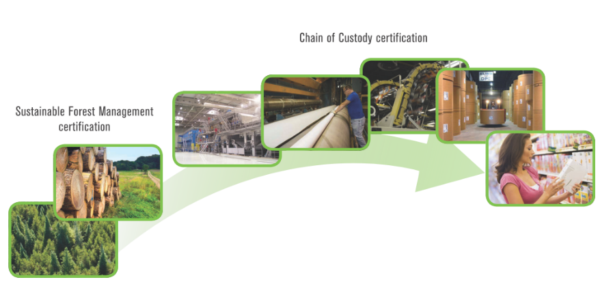
From forest management to end user
PEFC: More than 17 800 Chain of Custody in 70 countries
Ensuring:
legality
from well managed forest
traceability

Slide 18
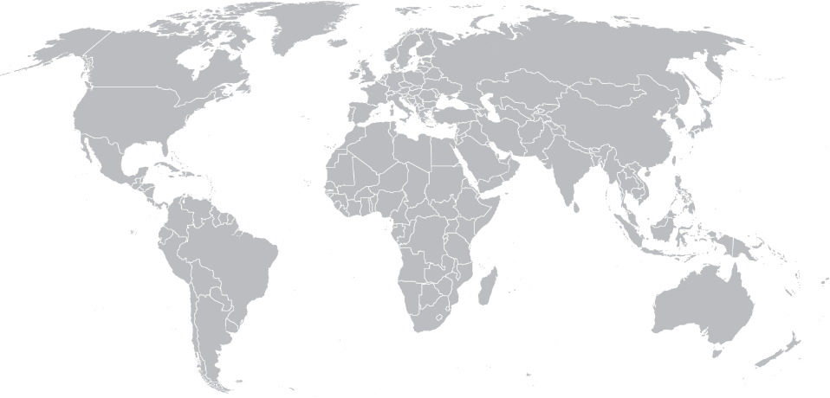
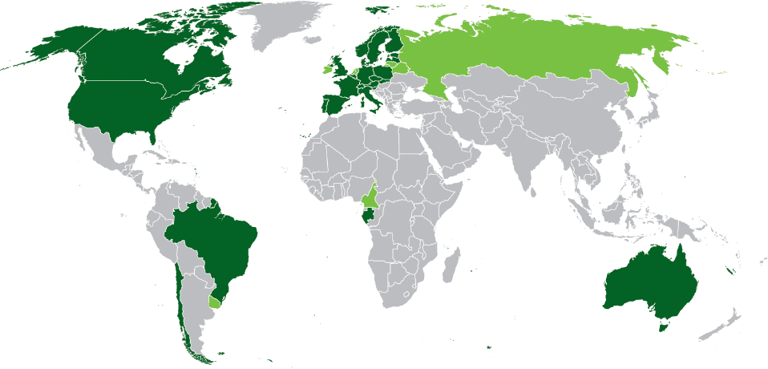
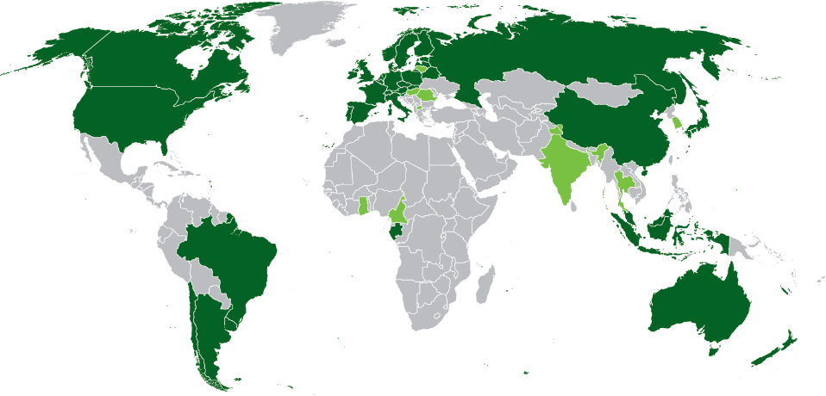
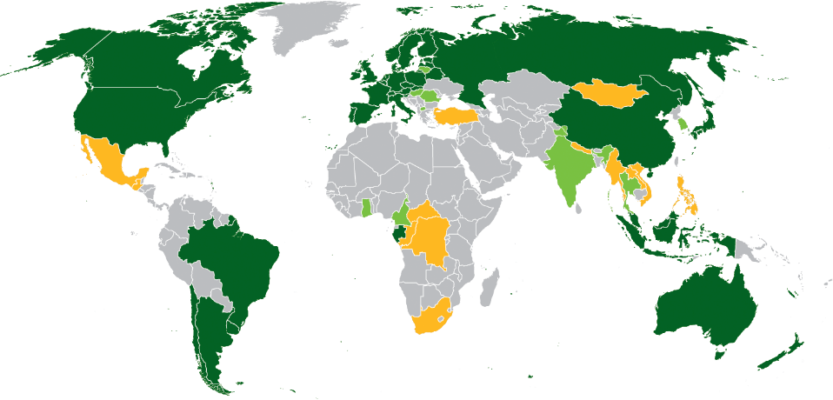
Global Growth of the PEFC Alliance
2016
2009
PEFC members with endorsed systems
PEFC members progressing towards endorsement
Countries actively developing systems
As of January 2009
As of November 2016

Slide 19





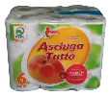






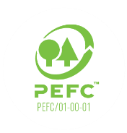











Behind the growth
Market drivers for certification
Legislation
Consumers
Public
procurement
Finance
Private
commitments
Private procurement

Slide 20




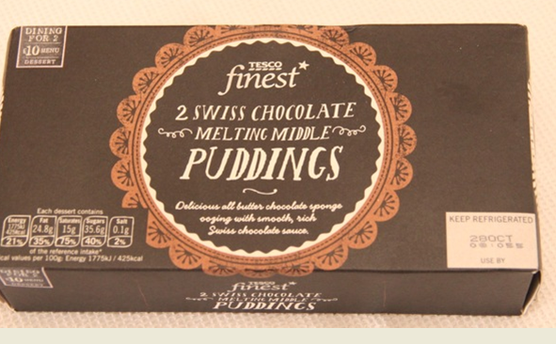


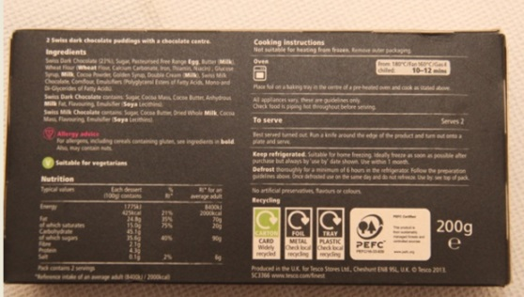
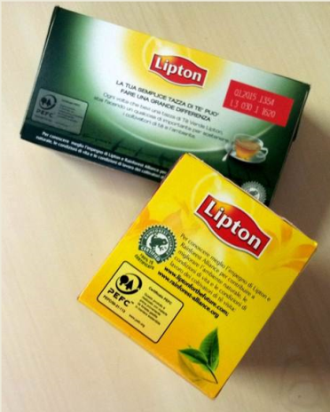
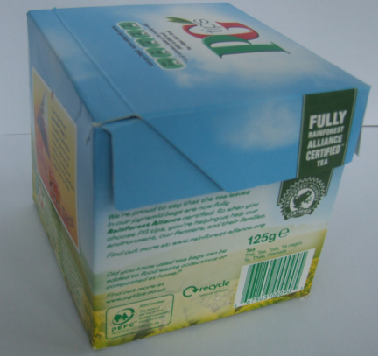
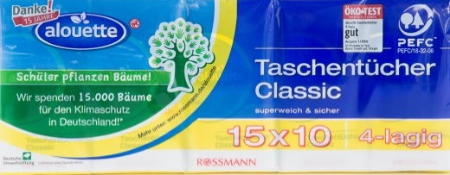


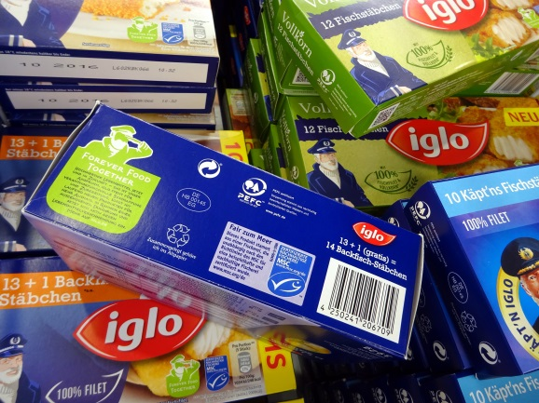

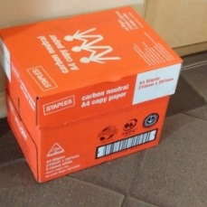
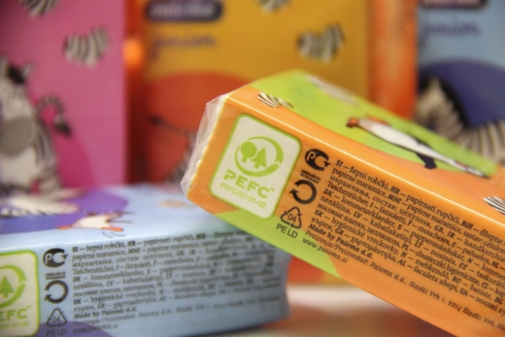





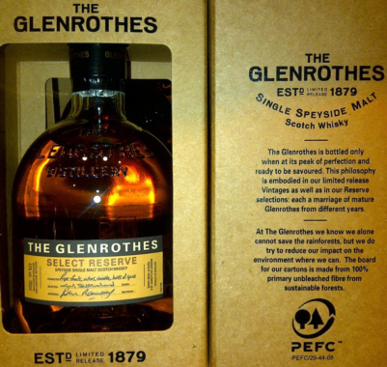

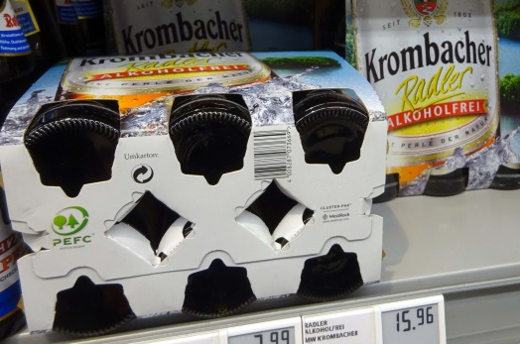
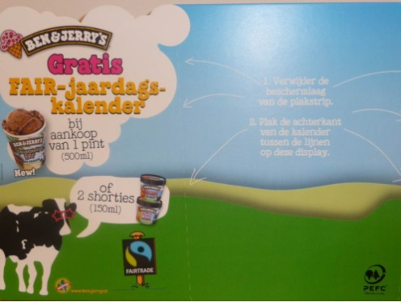

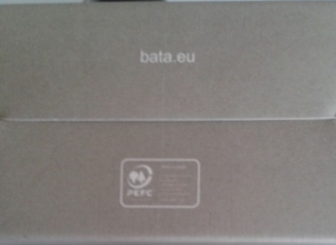
Brands who already benefit from PEFC label
Notes:
Low hanging fruits (mostly industrialized countries) have largely been certified, certification of "high hanging fruits" is more difficult (lack of enabling environment, costs, capacity etc)
this requires for forest management certification to demonstrate to a much higher degree benefits for forest owners and managers. As demand side requirements originate mainly from western countries, we have to have a much better look at the needs of the supply side à highlights the benefit of PEFC's approach of always working with local stakeholders, local ownership
we also need to reconsider whether we have the appropriate balance in SFM requirements, and whether these requirements adequately balance the need of the people as well as of the environment
this is further complicated by the raise of particular issues, such as "legality" and "deforestation-free" – these do not advance sustainability, so the heightened focus of these single issues may deflect from our need to promote sustainability
Finally, this all takes place within the context of the 2020 deadline, which many companies have set as a target to achieve "100% certified" – this may have unintended consequences if such targets are exclusive (specifying only one certification system) as this may lead to double certification rather than expansion of certified forest area, and, potentially more importunately, excludes a wide range of smallholders from accessing markets. Focus may be on large land areas instead of smallholders.

Slide 21
Technical Components
Scheme development, standard setting etc.

Slide 22
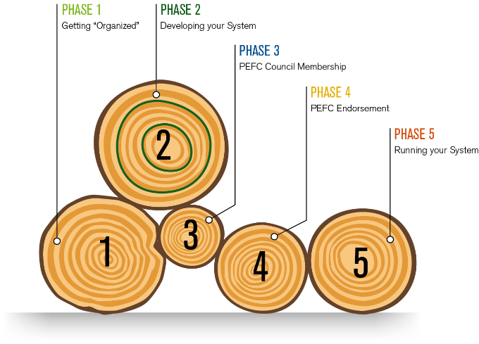

Developing a National Scheme
30%
20%
90%

Slide 23







Delivering Certificates
National Forest Certification System
IAF
AB (DoSQ)
Standards
Accredits
PEFC
NGB (MFCC)
CBs
Issue
certificates
Notifies
Chain of
Custody
use standards
Forest
Management
via Group
Certification

Slide 24







PEFC complaints mechanism
IAF
AB
Complaints
Mechanism
ISO/IEC 17011
IAF
Not satisfied
IAF PR1:2004
Satisfied
Not satisfied
CB
Complaints
Mechanism
DoS
Satisfied
IAF
Complaints
Mechanism
Satisfied
NGB
Complaints
Mechanism
ISO/IEC 17065
ISO/IEC 17021
GL7/2007
PEFC
Complaints
Mechanism
Not satisfied
MFCC
CB
Not satisfied
GL7/2007
CE
Complaints
Mechanism
PEFC
PEFC
PEFC ST 1003:2010
PEFC ST 2002:2013
National documentation
Certified
entity
Dispute
Satisfied

Slide 25
Certification Scheme Structure
Implementation Procedures
Administrative Procedures
Standard Setting
Standard Setting Procedures
Forest Management Standards
Notification of CBs
Certification and Accreditation Procedures
Chain of Custody Standard
Group forest management certification procedures
Disputes & complaints procedures
Logo usage licensing
Notes:
This table looks more closely at what documents – procedural, guidance or normative documents – need to be included in a national certification scheme.
- For some of these – like Chain of Custody - you can utilise PEFC International Stds
For others, you will need to closely read and understand PEFC International’s requirements, but then develop you own documentation
Forest Management Standard is just one document…

Slide 26
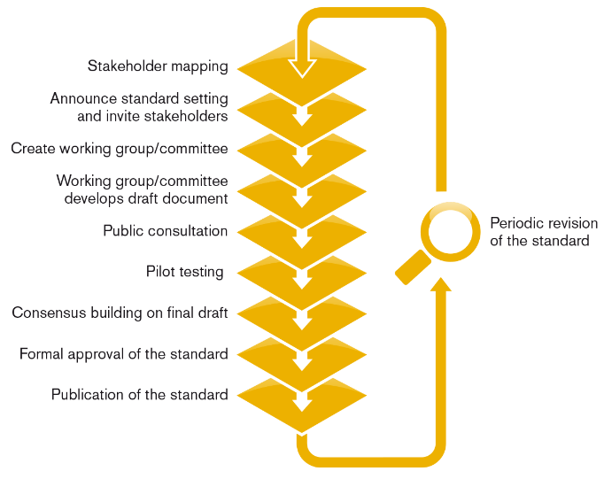
PEFC Standard Setting Process
Notes:
What are the big difference between us an normal AB process (only pilot testing and stakeholder mapping?)

Slide 27

International
Sustainability
Benchmarks
Global public consultation
Independent assessment
Panel of Experts
Board recommend-ation
Approval by members
Revision required
National Standard
Pilot testing
National public consultation
Consens-based decision making
Multi-stakeholder process
Application for Scheme Assessment
Notes:
PEFC’s bottom up approach contains a number of unique elements that ensure the robustness of the system and are not found in any other global forest certification system:
All standards are developed with stakeholder participation
All standards are assessed by an independent consultant for compliance with international requirements; assessment reports are available on www.pefc.org
Responsibility for approval lies with the General Assembly
All national standards must be revised every 5 years.
Further information about national standards: http://pefc.org/standards/national-standards and http://pefc.org/standards/national-standards/guidance
Further information about the endorsement process: http://pefc.org/standards/endorsement-mutual-recognition

Slide 28
MFCC Project
Working in partnership to bring sustainable management to Myanmar's forests
2017-2019

Slide 29
Working in partnership to bring sustainable management to Myanmar's forests
focus on delivering a national forest certification system
develop and test tools which support legal, sustainable and transparent forest product trade
build capacity while illustrating best practice
increasing the coordination between the many related donor and private sector projects & initiatives

Slide 30
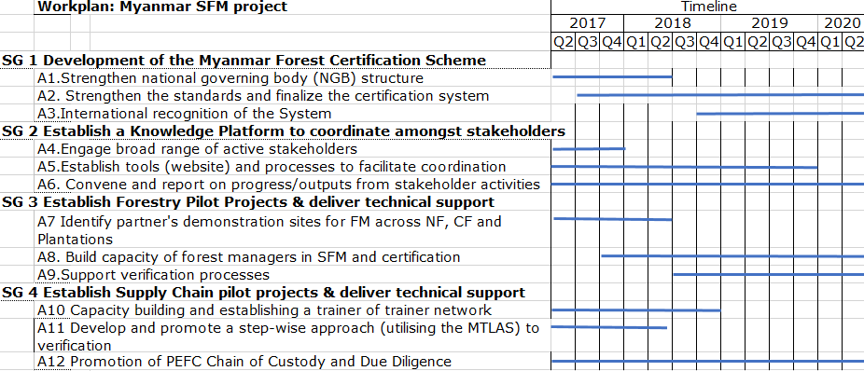
Workplan

Slide 31
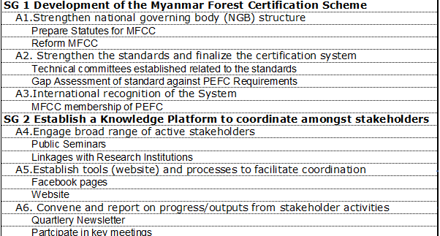
Year 1 Workplan (1)

Slide 32
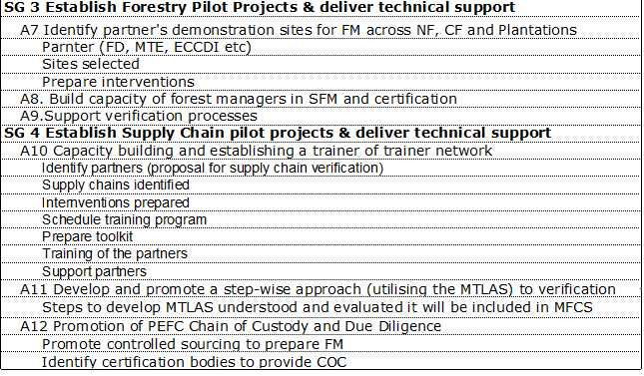
Year 1 Workplan (2)

Slide 33
National Scheme Development
MFCC will lead the process:
  Continue to convene stakeholders
  Build consensus on SFM
Provide a tool for forest managers and processors
Providing flagship examples of best practice:
  Stimulate policy development
  Build capacity
  Influencing the mainstream operations.

Slide 34
Knowledge Platform
- To support the MFCC in establishing a multi-stakeholder platform to facilitate better coordination and exchange amongst all forest sector actors
The platform will act as a central hub whereby partners can share experiences, project findings, tools and best practice
- To provide a network by which stakeholders can access technical support for testing certification solutions

Slide 35
Get Involved
Platform Membership
Benefits of MFCC Knowledge Platform
Information on Implementing MTLAS and Supply Chain Verification.
Participate in MFCC Events
  Ability to influence MFCC Decision Making.
  Nominate member for the Committee
  Suggest issues to MFCC Work plan.
  Share lesson learnt from their Organization and market requirements.
4. Access training, internships and scholarships.
5. Employment Opportunities with Project Partners.

Slide 36
Get Involved
FM Pilot Projects:
Pilot projects will focus on:
Natural Forests – Pilot FMU’s
Enhance Community Forests Value Chains
3) Existing Plantations – Private teak and rubber
4) Future Plantations – concessionaires etc

Slide 37
Supply Chain Verification Pilot Projects:
Work with interested companies to support the implementation of MTLAS
Use a step wise approach
Support companies towards 3rd party verified Chain of Custody certification.
Develop tools for companies to implement supply chain verification (manuals, documents, risk assessment frameworks)
Promotion of PEFC CoC including the Due Dilligence system

Slide 38
Stepwise for SFM in MFCC project
PEFC Certified
Verification Claim
International Recognised Labelling
FM Std environment social, economic standard
PEFC DDS Controlled Sources
MTLAS
International 3rd party accreditation and CB’s
National 3rd Party Accreditation and CB’s
2nd party
Core forest values (no controversial sources)
1st party
MTLAS P&C
No claim
Unverified statement of origin
Buyers direct assessment
Verified legal
Source unknown
Traceability system
Full chain of custody system
Notes:
Laity and Crawford 2012

Slide 39

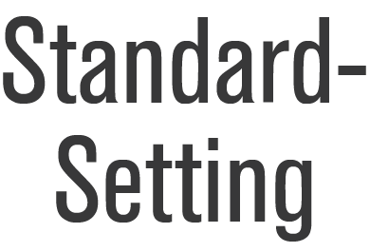
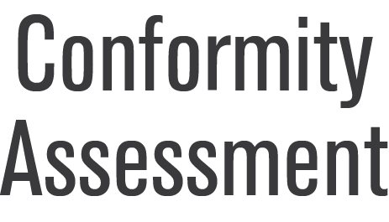

MTLAS processes (2017-19)
MFCC
MTLAS P& C
Guidance Docuements
MTLAS
CB Requirements
MTLAS
MTLAS
Auditor Requirements

Slide 40
MTLAS moving towards the ISO Framework (2019+)
IAF Procedures
ISO/IEC 17011
MTLAS
National documentation
ISO
ISO/IEC Guide 59
ISO Guide 82
ISO/IEC Guide 2
ISO/IEC 17007
ISO/IEC 17021
ISO/IEC 17065
ISO 19011
MTLAS
Auditors
ISO 9001
ISO 19011

Slide 41
MTLAS incorporated in MFCS
Myanmar Forest Certification Scheme
IAF
DoS (AB)
Standards
Accredits
PEFC
MFCC
CBs
Issue
certificates
Notifies
SCHEME DOCUMENTS
MTLAS
via Group
Certification
CoC
MTLAS
DDS

Slide 42
Get Involved as a supply chain verification partner
Assessing innovation and technical solutions required to deliver PEFC CoC solutions
Supply chain verification partnership to address your needs such as:
    Upstream training and capacity building of your suppliers
    Downstream cooperation to engage actors and be proactive in meeting your market requirements
Developing the MFCC CoC technical department which support PEFC CoC in Myanmar

Slide 43
MFCC Project: Questions and discussion
Based on the 4 main parts of the project. What are the key issues to be considered?
Strengthening MFCC
Knowledge Platform
MFCC a multi-stakeholder governing body
Scheme development
Linking with other projects and initiatives
Building awareness
SFM Pilot Projects
Supply Chain Partnerships
SFM Partners
Implementing SFM
Step-wise approach
Engaging markets

Slide 44
Questions
Thanks!
Richard.laity@pefc.org

